Slide 1
Wedding vibes
Group Members:
Muhammad Ali
Raja Shujaat
Bilal Nisar
Supervised by:
Dr. AMER NADEEM

Slide 2
Introduction
Wedding Vibes System will provide a platform for customers to make online reservation on available dates. It will be time saving for users to book marquee online.
Wedding Vibes System is an online platform which facilitates the process of booking marquee and it’s all services. Wedding Vibes system is providing fully automated wedding ceremony from reservation to billing. Wedding Vibes system provides online scheduling of dates to book online.

Slide 3
Selected Functional Requirement
S. No. | Functional Requirement | Type
1 | User can Sign up. | New
2 | User can sign in. | New
3 | The system must be able to manage customers wedding reservation. | New
4 | System will find the availability of dates. | New
5 | User can select Desired menu. | New

Slide 4
Non Functional Requirements
S. No. | Non-Functional Requirements | Category
1 | The system should authenticate all users | Security
2 | System should give help for signing up and entering password/username | Usability
3 | Authorization and authentication should be done in secure connection. | Security
4 | The system should be able to handle multiple transactions at a time. | Reliability
5 | Customer need to cancel the booking before 24hours of event otherwise their compensation money will be charged. | Reliability

Slide 5
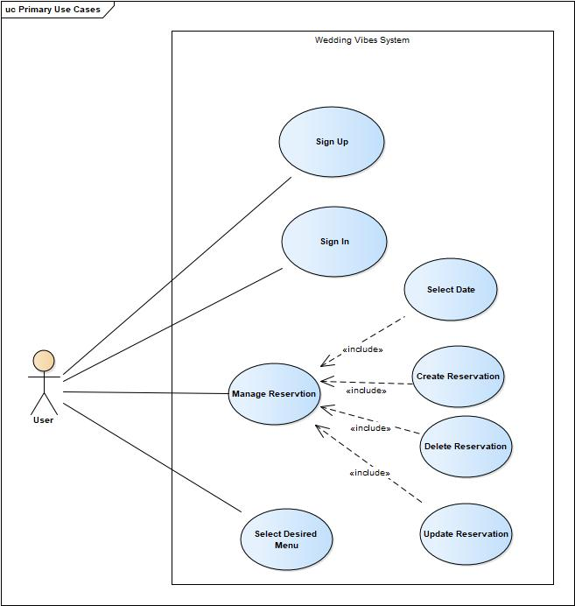
Use case

Slide 6
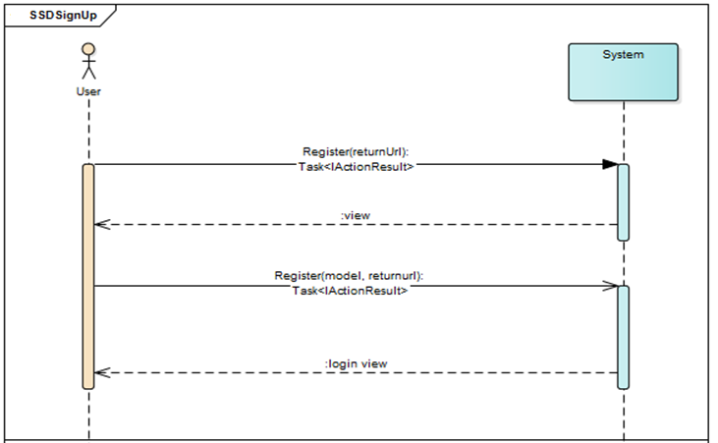
SSD Signup

Slide 7
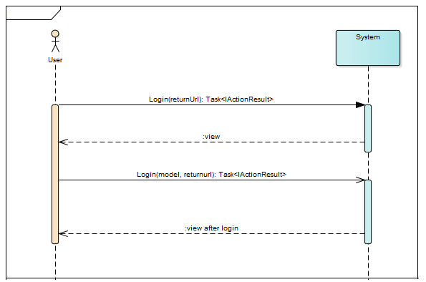
Sign In

Slide 8
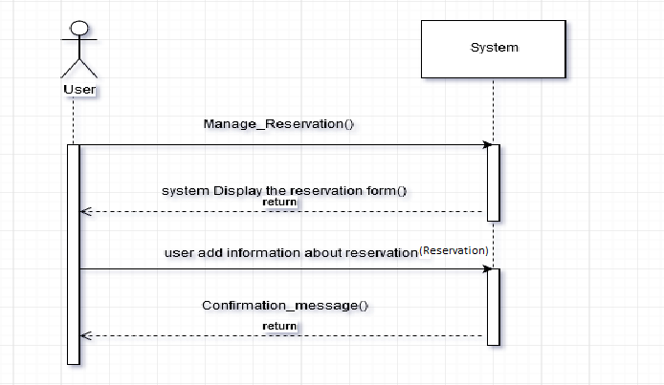
SSD Reservation

Slide 9
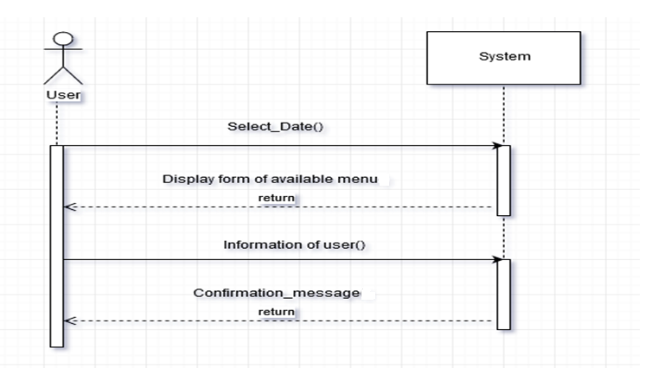
Select Date

Slide 10
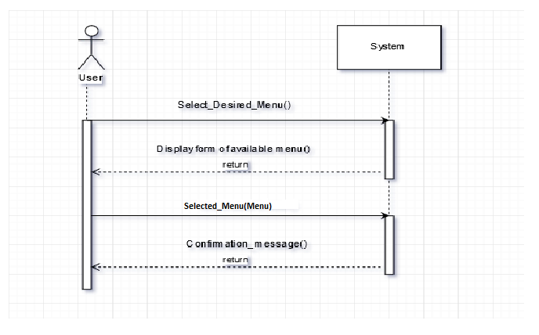
Select Desire Menu

Slide 11
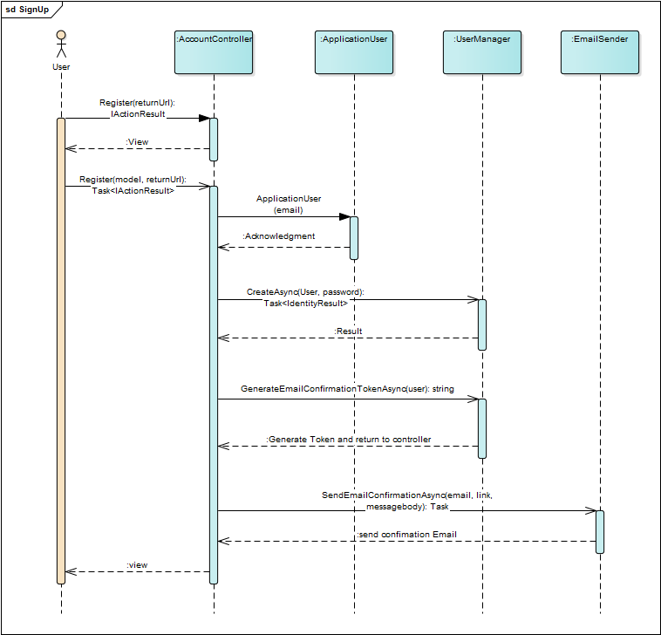
SD Sign up

Slide 12
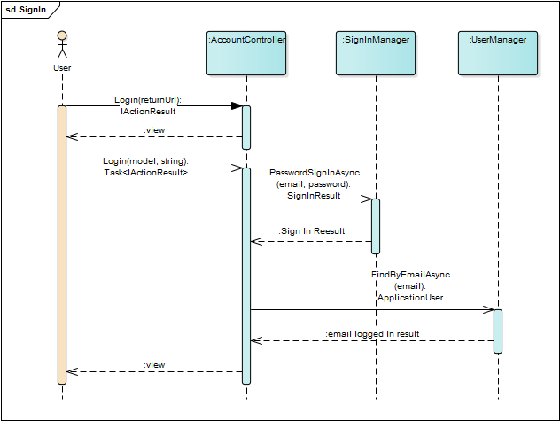
SD Sign In

Slide 13
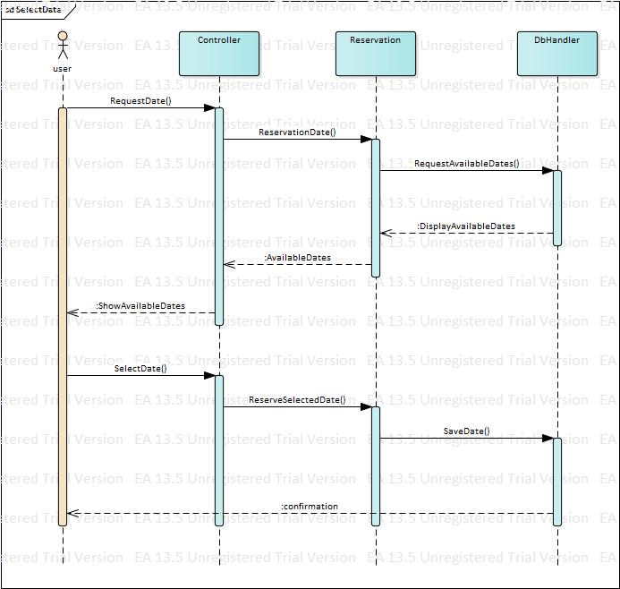
Select Date

Slide 14
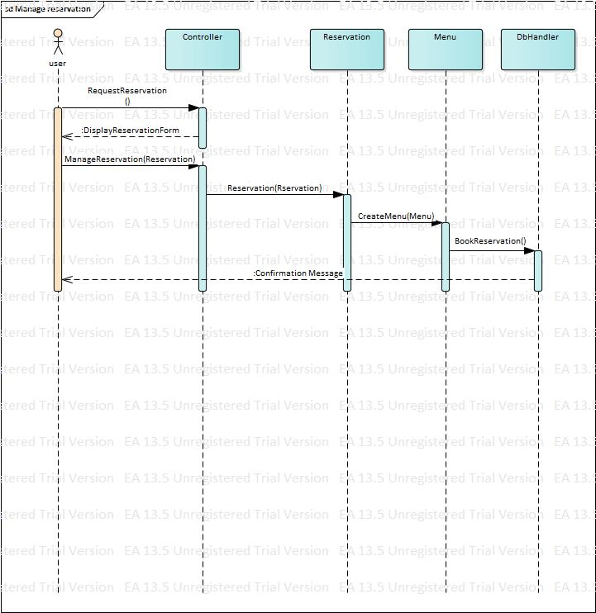
Sd Reservation

Slide 15
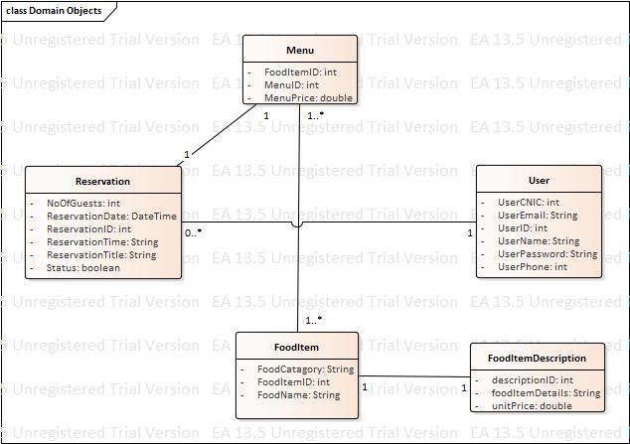
Domain Model

Slide 16
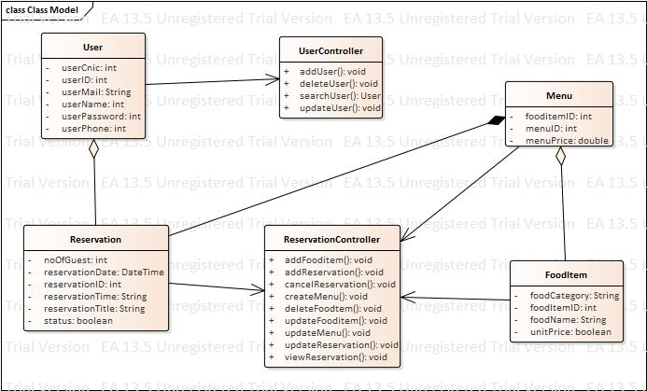
Class Diagram

Slide 17
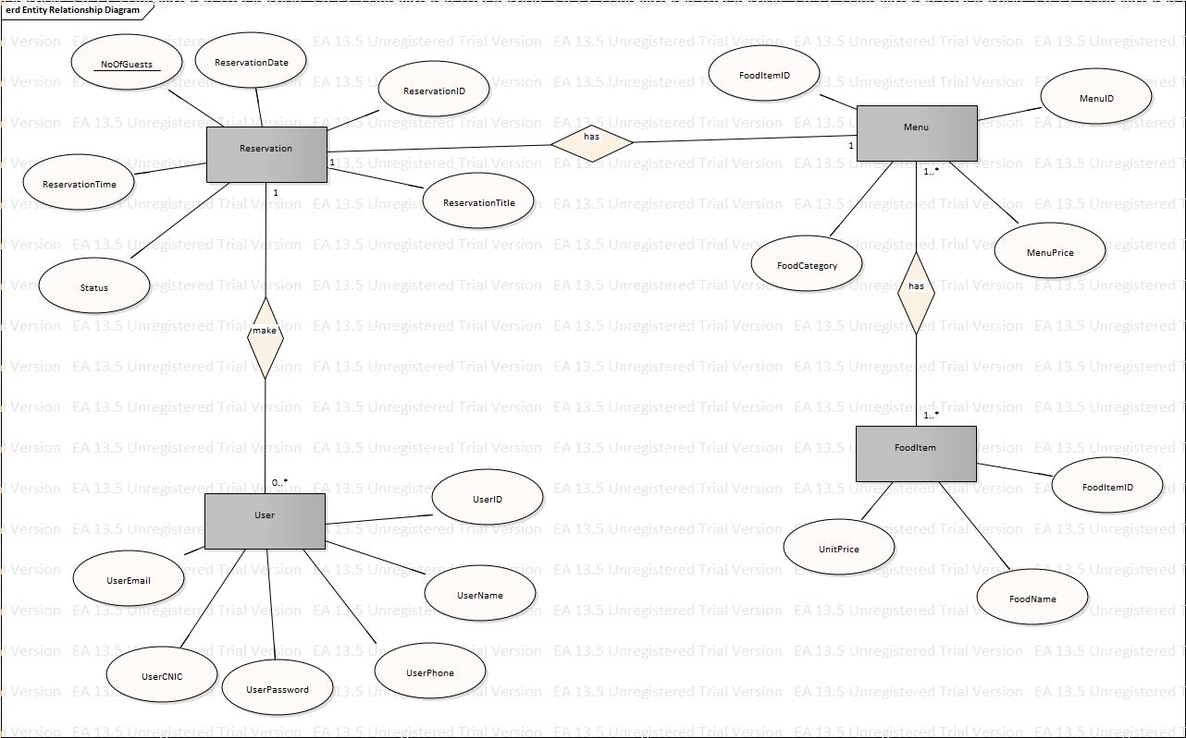
ERD

Slide 18
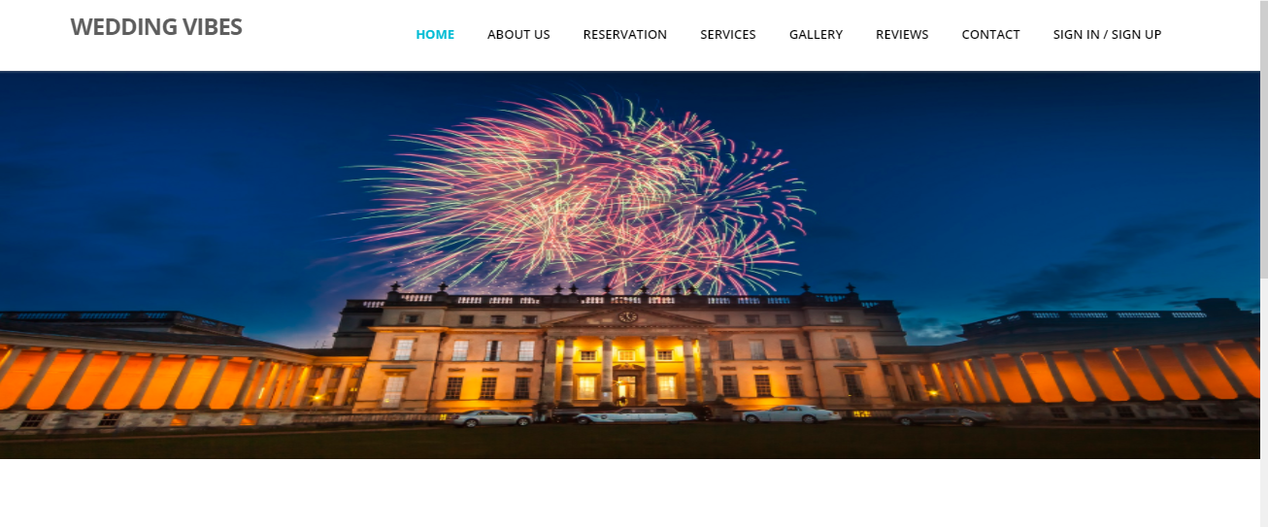
Interface

Slide 19
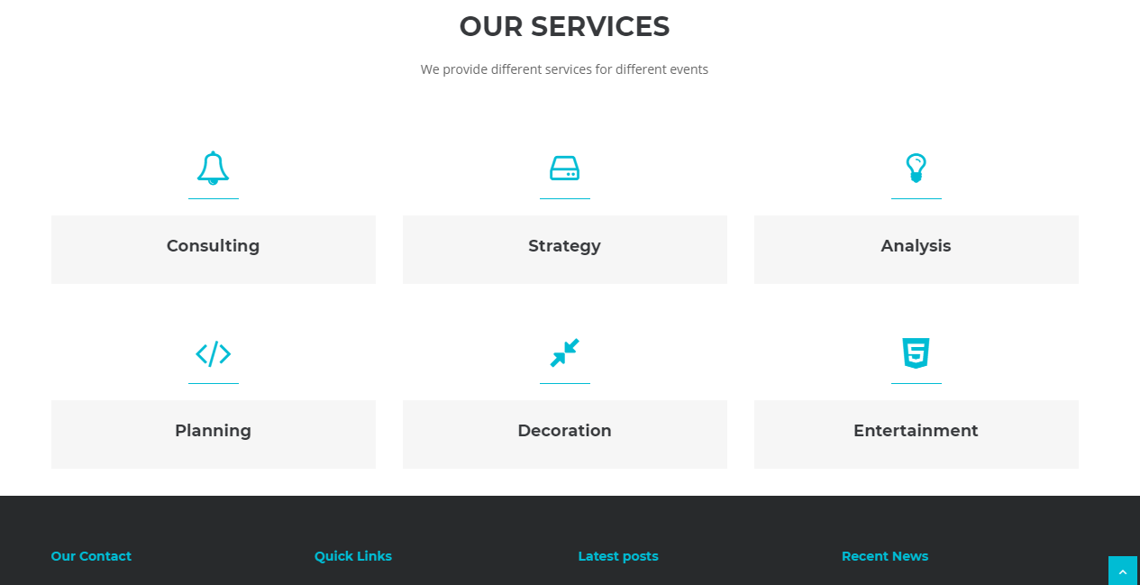

Slide 20
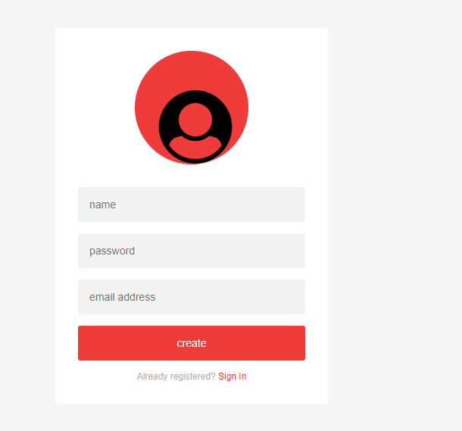
Sign up

Slide 21
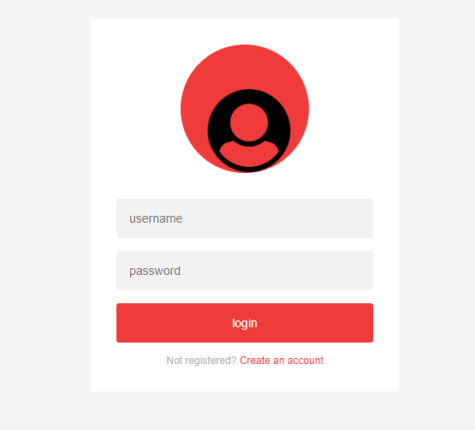
Sign In

Slide 22
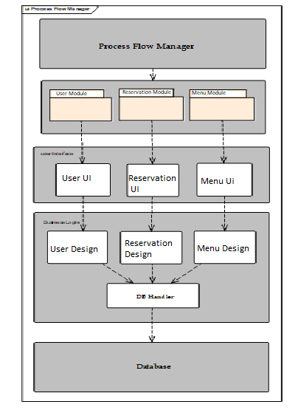
Software Architecture

Slide 23
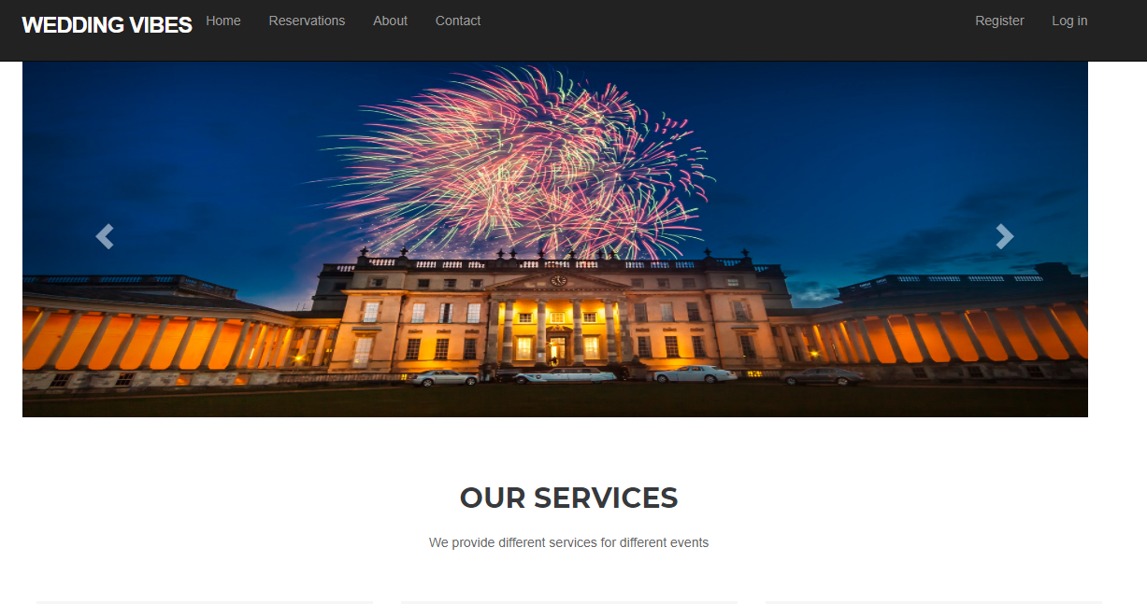
Home page

Slide 24
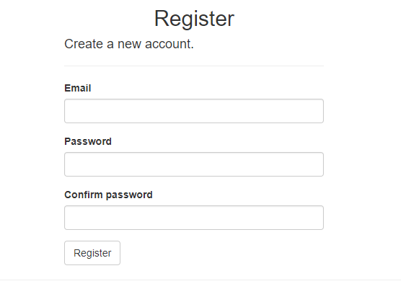
Register

Slide 25
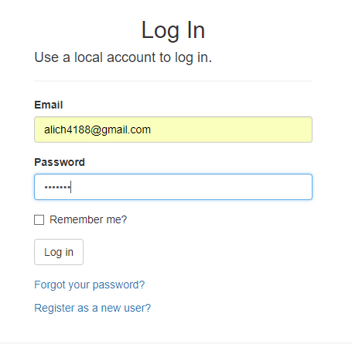
login

Slide 26
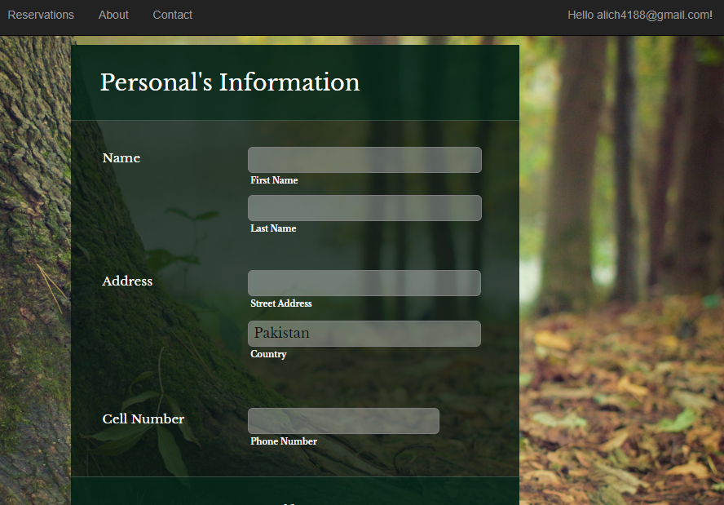
Reservation

Slide 27
Testing Environment
Black box testing is used in testing. For example, in a black box test on a software design the tester only knows the inputs and what the expected outcomes should be and not how the program arrives at those outputs. The tester does not ever examine the programming code and does not need any further knowledge of the program other than its specifications.

Slide 28
Test Case 1:
This test case is generated to test the password validation of system during the registration process when user is trying to gets register to website.

Slide 29
Test Case 1:
Date: 26 June 2018
System: Wedding Vibes
Objective: Registration/Password Validation | Test ID:1
Version:1 | Test Type: Black Box testing
Input: Email: anymail@outlook.com Password: 1234
Expected Result: The Password must be at least 6 and at max 100 characters long.
Actual Result: Passed

Slide 30
Test Case 2:
The test case is designed to test the email validation during registration and login process of system when user is entering invalid email address.

Slide 31
Test Case 2:
Date: 28 June 2018
System: Wedding Vibes
Objective: Registration/ Email Validation | Test ID:2
Version:1 | Test Type: Black Box testing
Input: Email Id: ali
Expected Result: The Email field is not a valid e-mail address.
Actual Result: Passed

Slide 32
